Slide 1

Micro Credit Defaulter Project
By
KOUSHIK BISWAS

Slide 2
TABLE OF CONTENTS
Abstruct
Introduction
Problem Statement
Conceptual Background of the Domain Problem
Data Sources and their formats
About The DataSet
Data Preprocessing
Hardware and Software Requirements and Tools Used
selected models
Accuracy score of the model
Parameter tuning
Final model
ROCAUC Curve of final model
Table of predicted and original data
Interpretation of the Results
Conclussion

Slide 3
Abstruct
The initiative of the company to provide Micro credit is very noble to help the low-income group of people but there are certain people who take advantage of this noble idea and don’t bother to repay the money and become defaulter. So, it is necessary to stop this type of practice. Sometime people with good intension remain deprived of getting loan from the financial institution due to some dishonest people. Hence Machine Learning can be used to predict the defaulter and non-defaulter by using different parameters.

Slide 4
Introduction
The company is a fixed wireless telecommunications network provider. They have launched various products and have developed its business and organization based on the budget operator model, offering better products at Lower Prices to all value conscious customers through a strategy of disruptive innovation that focuses on the subscriber. The company know the importance of communication so they have also focused on providing product and services to low-income families. To do this, they have a collaboration with MFI to provide micro credit on mobile balances to be paid back in 5 days. The customer is considered as defaulter if he fails to pay the sum of money within the stipulated period of time. For the loan amount of 5 (in Indonesian Rupiah), payback amount should be 6 (in Indonesian Rupiah), while, for the loan amount of 10 (in Indonesian Rupiah), the payback amount should be 12 (in Indonesian Rupiah). Many people struggle to get loans due to insufficient or non-existent credit histories. And, unfortunately, this population is often taken advantage of by untrustworthy lenders. In order to make sure this underserved population has a positive loan experience; company makes use of a variety of alternative data include transactional information--to predict their clients' repayment abilities.
Now we Builded a model which can be used to predict in terms of a probability for each loan transaction, whether the customer will be paying back the loaned amount within 5 days of insurance of loan. In this case, Label ‘1’ indicates that the loan has been payed i.e. Non- defaulter, while, Label ‘0’ indicates that the loan has not been payed i.e. defaulter.

Slide 5
Problem Statement
A Microfinance Institution (MFI) is an organization that offers financial services to low income populations. MFS becomes very useful when targeting especially the unbanked poor families living in remote areas with not much sources of income. The Microfinance services (MFS) provided by MFI are Group Loans, Agricultural Loans, Individual Business Loans and so on.
Many microfinance institutions (MFI), experts and donors are supporting the idea of using mobile financial services (MFS) which they feel are more convenient and efficient, and cost saving, than the traditional high-touch model used since long for the purpose of delivering microfinance services. Though, the MFI industry is primarily focusing on low income families and are very useful in such areas, the implementation of MFS has been uneven with both significant challenges and successes.
Today, microfinance is widely accepted as a poverty-reduction tool, representing $70 billion in outstanding loans and a global outreach of 200 million clients.
We are working with one such client that is in Telecom Industry. They are a fixed wireless telecommunications network provider. They have launched various products and have developed its business and organization based on the budget operator model, offering better products at Lower Prices to all value conscious customers through a strategy of disruptive innovation that focuses on the subscriber.
They understand the importance of communication and how it affects a person’s life, thus, focusing on providing their services and products to low income families and poor customers that can help them in the need of hour.
They are collaborating with an MFI to provide micro-credit on mobile balances to be paid back in 5 days. The Consumer is believed to be defaulter if he deviates from the path of paying back the loaned amount within the time duration of 5 days. For the loan amount of 5 (in Indonesian Rupiah), payback amount should be 6 (in Indonesian Rupiah), while, for the loan amount of 10 (in Indonesian Rupiah), the payback amount should be 12 (in Indonesian Rupiah).

Slide 6
Conceptual Background of the Domain Problem
Many people struggle to get loans due to insufficient or non-existent credit histories. And, unfortunately, this population is often taken advantage of by untrustworthy lenders. In order to make sure this underserved population has a positive loan experience, company makes use of a variety of alternative data include transactional information--to predict their clients' repayment abilities.

Slide 7
Data Sources and their formats
The dataset provided by FlipRobo Technology. The dataset contains 209593 rows and 37 columns having both numerical and categorical data.
In this dataset " label" is our target variable which has only two values 0 and 1(Label ‘1’ indicates that the loan has been payed i.e. Non- defaulter, while, Label ‘0’ indicates that the loan has not been payed i.e. defaulter ). So this is a “Clssification" problem.
you can download the dataset from the below link.
Dataset link:
https://github.com/KBkoushik/Micro-Credit-Defaulter-project-.git

Slide 8
About The DataSet
label | Flag indicating whether the user paid back the credit amount within 5 days of issuing the loan{1:success, 0:failure}
msisdn | mobile number of user
aon | age on cellular network in days
daily_decr30 | Daily amount spent from main account, averaged over last 30 days (in Indonesian Rupiah)
daily_decr90 | Daily amount spent from main account, averaged over last 90 days (in Indonesian Rupiah)
rental30 | Average main account balance over last 30 days
rental90 | Average main account balance over last 90 days
last_rech_date_ma | Number of days till last recharge of main account
last_rech_date_da | Number of days till last recharge of data account
last_rech_amt_ma | Amount of last recharge of main account (in Indonesian Rupiah)
cnt_ma_rech30 | Number of times main account got recharged in last 30 days
fr_ma_rech30 | Frequency of main account recharged in last 30 days
sumamnt_ma_rech30 | Total amount of recharge in main account over last 30 days (in Indonesian Rupiah)
medianamnt_ma_rech30 | Median of amount of recharges done in main account over last 30 days at user level (in Indonesian Rupiah)
medianmarechprebal30 | Median of main account balance just before recharge in last 30 days at user level (in Indonesian Rupiah)
cnt_ma_rech90 | Number of times main account got recharged in last 90 days
fr_ma_rech90 | Frequency of main account recharged in last 90 days
sumamnt_ma_rech90 | Total amount of recharge in main account over last 90 days (in Indonasian Rupiah)
medianamnt_ma_rech90 | Median of amount of recharges done in main account over last 90 days at user level (in Indonasian Rupiah)
medianmarechprebal90 | Median of main account balance just before recharge in last 90 days at user level (in Indonasian Rupiah)
cnt_da_rech30 | Number of times data account got recharged in last 30 days
fr_da_rech30 | Frequency of data account recharged in last 30 days
cnt_da_rech90 | Number of times data account got recharged in last 90 days
fr_da_rech90 | Frequency of data account recharged in last 90 days
cnt_loans30 | Number of loans taken by user in last 30 days
amnt_loans30 | Total amount of loans taken by user in last 30 days
maxamnt_loans30 | maximum amount of loan taken by the user in last 30 days
medianamnt_loans30 | Median of amounts of loan taken by the user in last 30 days
cnt_loans90 | Number of loans taken by user in last 90 days
amnt_loans90 | Total amount of loans taken by user in last 90 days
maxamnt_loans90 | maximum amount of loan taken by the user in last 90 days
medianamnt_loans90 | Median of amounts of loan taken by the user in last 90 days
payback30 | Average payback time in days over last 30 days
payback90 | Average payback time in days over last 90 days
pcircle | telecom circle
pdate | date

Slide 9
Data Preprocessing
For the purpose of the project the dataset has been preprocessed as follows:
Checking missing value
we divide all the columns into categorical and numerical types
Univariate Analysis Of Categorical Columns and numerical columns.
Checking correlation with target column using Heatmap
Checking skewness of each columns
Handling missing value
Checking Outliers and removing outliers by zscore
Encoding the categorical column by Label Encoder
Dividing data into features and vectors
Checking VIF score
Removing skewness by power transform method
Standardizing the data by standard scaler

Slide 10
Hardware and Software Requirements and Tools Used
Hardware:- Desktop/Laptop
Software:- Anaconda

Slide 11
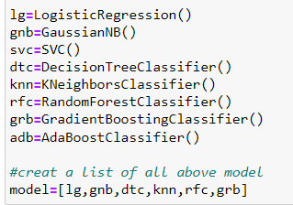
selected models
I used 6 different classification algorithms to get the ideal one for prediction.

Slide 12
Accuracy score of the model
Model Name | Accuracy Score
LogisticRegression | 0.7631922721988519
GaussianNB | 0.7377245652512614
DecisionTreeClassifier | 0.9049245556634188
KNeighborsClassifier | 0.8557029686357699
RandomForestClassifier | 0.9442466951904984
GradientBoostingClassifier | 0.9026114886324141

Slide 13
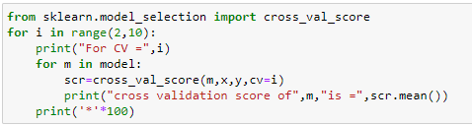
Cross Val Score
After Runing this code we get best cross val score from RandomforestRegressor for CV=5.So,we choose Random Forest Classifier for Parameter Tuning

Slide 14
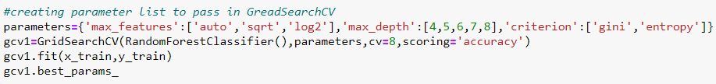
Parameter tuning
Parameter Tuning Code
Accuracy score has increased after parameter tuning of RandomforestRegressor .So we choose it as a final model and save the model by joblib.

Slide 15
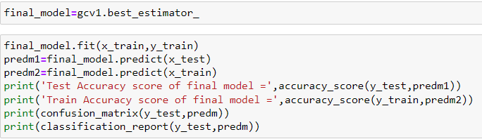
Final model
After running this code we can see difference between train accuracy and test accuracy is very less ,our final model is not overfit or underfit.

Slide 16
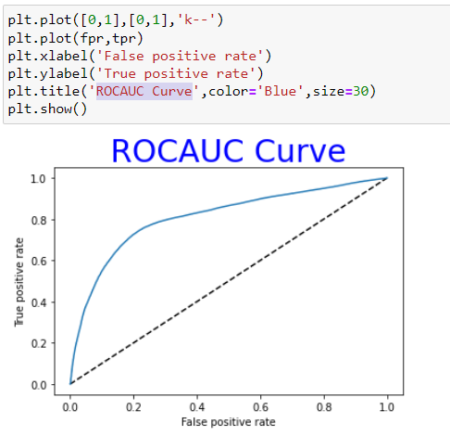
ROCAUC Curve This is our ROCAUC Curve of the final model

Slide 17
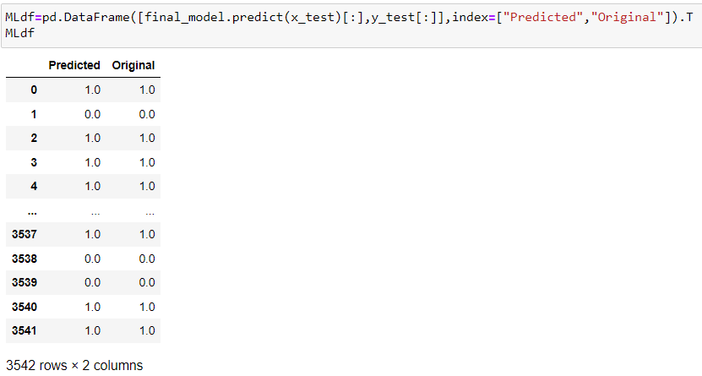
Table of predicted and original data
We can see that the original data and predicted data are almost same which means model performance is good.

Slide 18
Interpretation of the Results
This particular problem needs a good vision on data, and in this problem Feature Engineering is the most crucial thing.
You can see how we have handled numerical and categorical data and how we build different machine learning models on the same dataset.
It is always advised to all of us that atleast we need to use 5 Algorithm in order to figure out which one is performing best among them and we choose that one and we send that for hyper parameter tuning to know that best parameter .
Using hyper parameter tunning we can improve our model accuracy, for instance in this model the accuracy increased.

Slide 19
Future Work
For future improvements, following step we thought to took-
Replacing model with a latest/different model
Using other robust datasets
Predicting result on differents attributes

Slide 20
Conclussion
When I was working on this project, many complications were involved. There are many variables / attributes to consider in determining our target value, we need a lot of calculating power to get near 100% accuracy result . And it is very difficult to accurately predict the holder defaulter or not.
For any of machine learning project my suggestion is first you have to understand the problem on ground level .if you don’t allow yourself to work with diligence .if you don’ t work harder anything that you are doing or will do , not only in case of machine learning but also in life cycle would be futile. Maybe, my endeavour assist you when ever you will get stuck

Slide 21
THANK YOU

